Slide 1



Slide 2
Agenda
Operating system
History of Linux
What is Linux
Structure Of Linux
Difference between Linux and windows
Basic Linux commands
User management
File management
Networking commands
Filter commands
Crontab

Slide 3
Operating system
An Operating System (OS) is an interface between a computer user and computer hardware. An operating system is a software which performs all the basic tasks like file management, memory management, process management, handling input and output, and controlling peripheral devices such as disk drives and printers.

Slide 4

Different types of operating systems

Slide 5
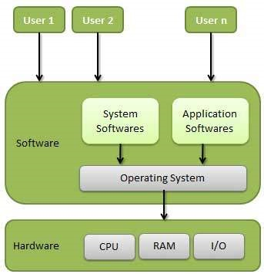
Architecture of operating system

Slide 6

Components of operating system

Slide 7
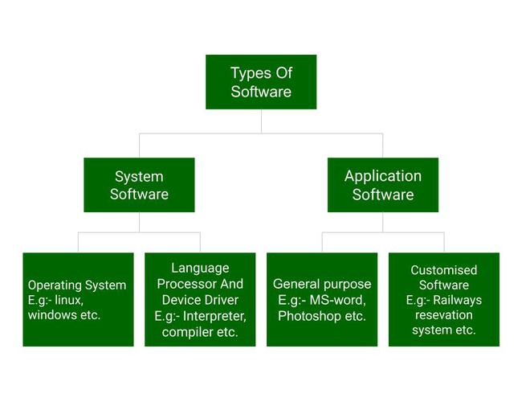
Types of software

Slide 8
LINUX

Slide 9

History of linux
Linux began in 1991 as a personal project by Finnish student Linus Torvalds to create a new free operating system kernel. The resulting Linux kernel has been marked by constant growth throughout its history. Since the initial release of its source code in 1991, it has grown from a small number of C files under a license prohibiting commercial distribution to the 4.15 version in 2018 with more than 23.3 million lines of source code, not counting comments, under the GNU General Public License.
Firstly he wanted to name it as 'Freax' but later it became 'Linux'.
He published the Linux kernel under his own license and was restricted to use as commercially. Linux uses most of its tools from GNU software and are under GNU copyright. In 1992, he released the kernel under GNU General Public License.

Slide 10
What is linux
Linux is a family of open-source, multitasking, multiuser computer operating systems based on the Linux kernel.
Linux is typically packaged in a Linux distribution.
The source code can be modified & distributed to anyone commercialy or non-commercialy under
GNU-General public license.
Initially Linux was created for personal computer & Gradualyit was used in other machines like supercomputers, smart phones, desktop, web servers, tablet, laptops and home appliances like washing machines, DVD players, routers, modems, cars, refrigerators, etc use Linux OS.

Slide 11

Linux distribution :
It is an os that is made up of a collection of software based on linux kernel or say distribution contains the linux kernel & supporting libraries & software.

Slide 12
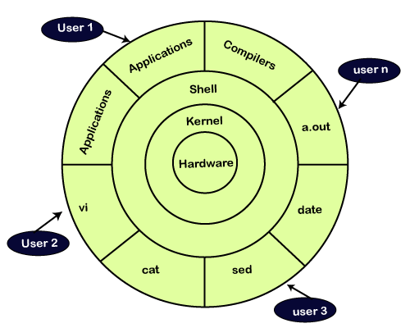
Kernel
Linux kernel is the core part of the operating system. It establishes communication between devices and software

Slide 13
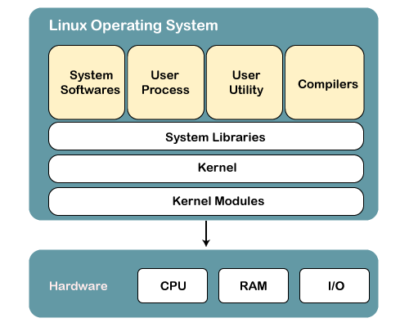
Structure Of Linux Operating System

Slide 14
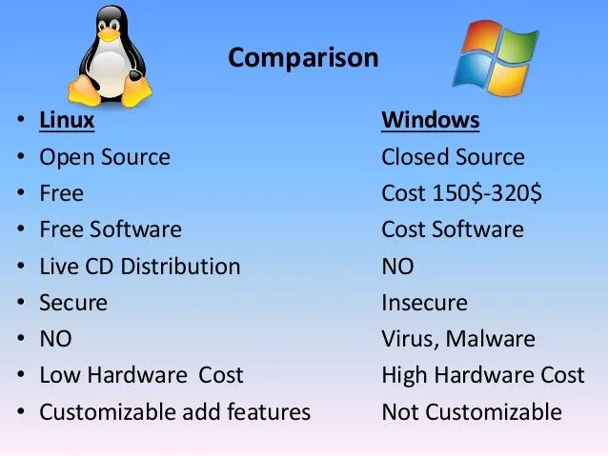
Difference between Windows & Linux

Slide 15
What is Command
A Linux command is a program or utility that runs on the command line. A command line is an interface that accepts lines of text and processes them into instructions for your computer.

Slide 16
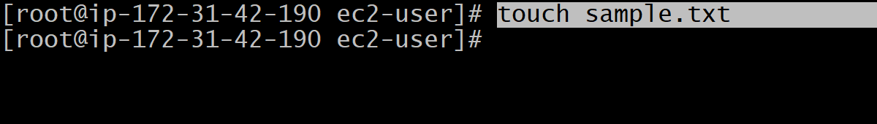
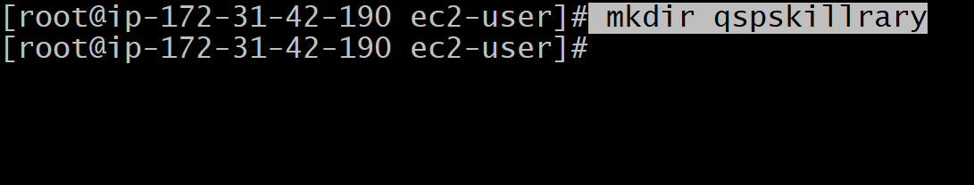
Basic linux commands
Touch : To create a file.
Mkdir : To create a folder.

Slide 17
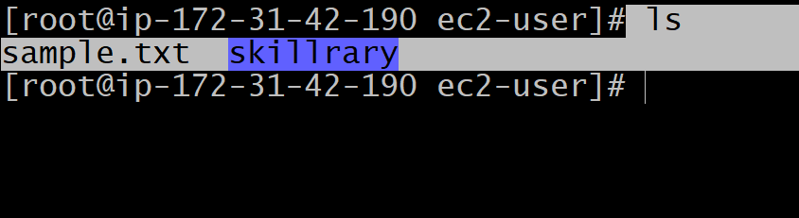
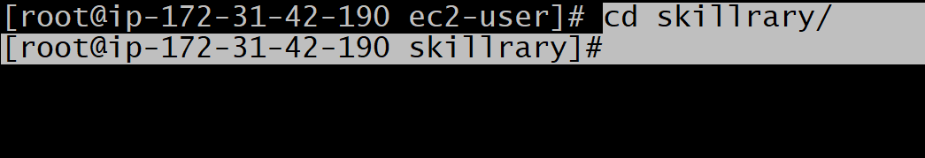
Ls : It will display the files or folders present in directory.
cd : Change directory.

Slide 18
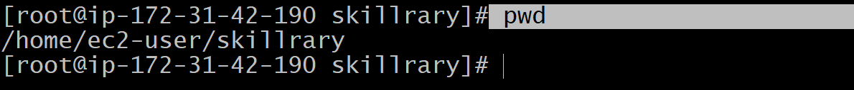
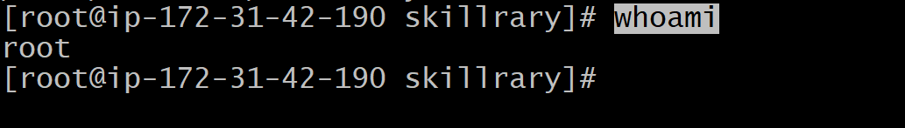
Pwd : print working directory.
Whoami : To know the user name.

Slide 19
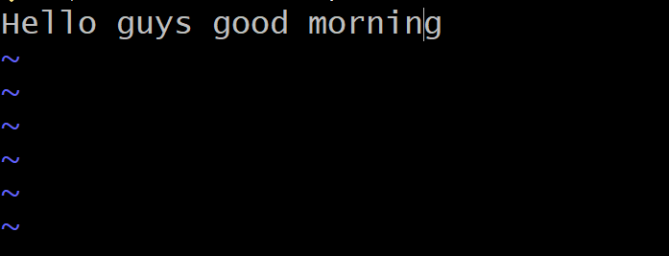
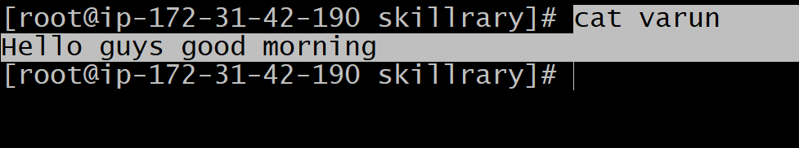
Vi file_name/nano: It will open the editor.
Cat file_name : It will display the content present in the particular file

Slide 20
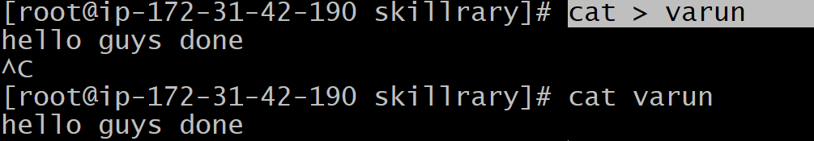
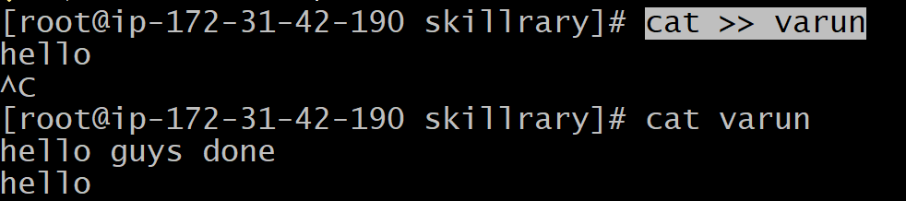
Cat > file_name : It will override the content present in the file.
Cat >> file_name : To add the content in the file without overriding.

Slide 21
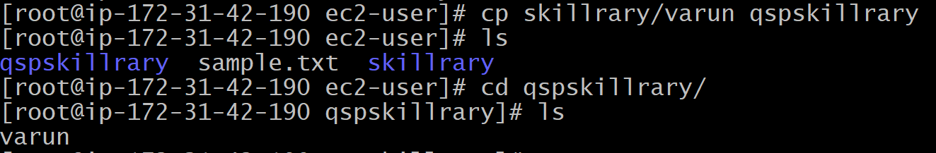
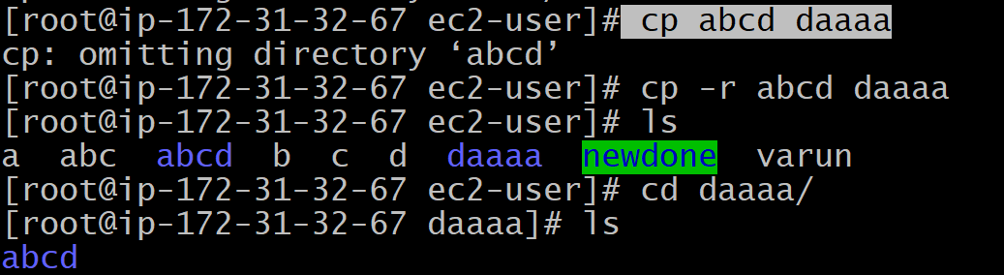
cp : To copy the file from one path to another path.
Cp –r : Option 'r' with the copy command can be used to copy a directory including all its content from a source directory to the destination directory.
syntax : cp -r <sourceDirectory> <destinationDirectory>

Slide 22
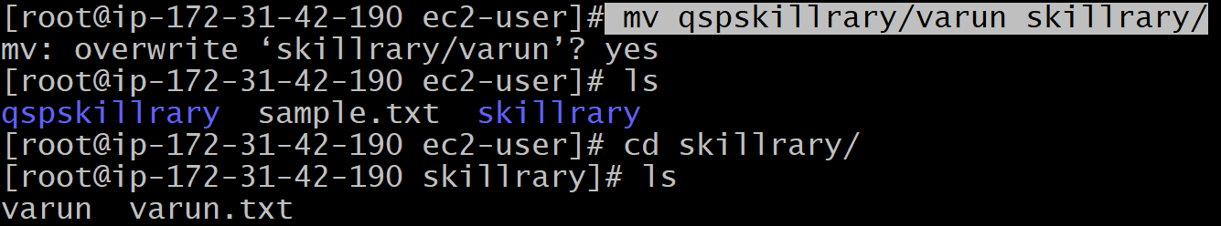
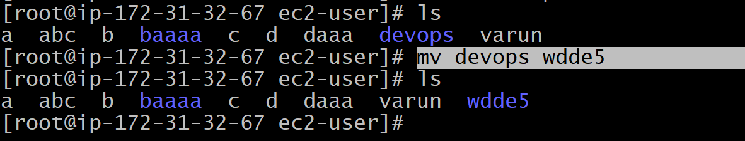
mv : To move the file from one path to another path.
mv : By using this we can rename the file or directory.

Slide 23
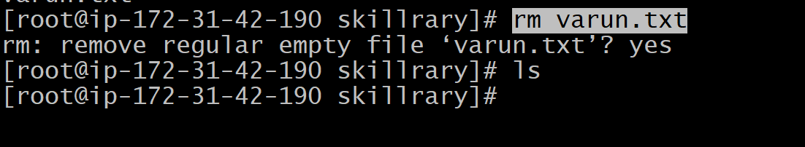
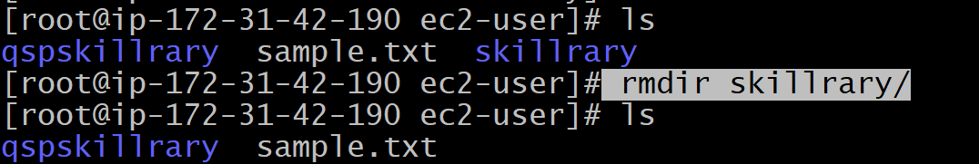
rm : To delete the file.
rmdir : To delete the folder.

Slide 24
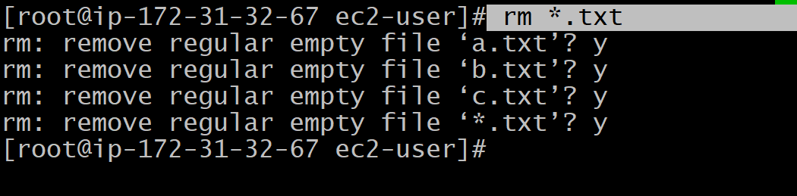
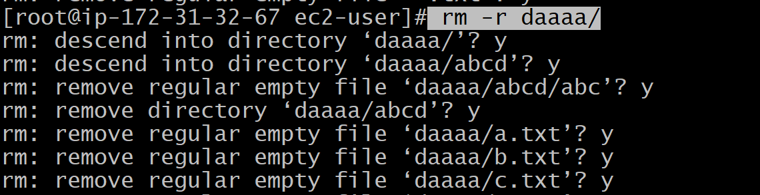
rm *.<extension> :- By using this command we can delete the multiple files with same extension.
rm –r : With rm '-r' option, you can delete a directory having sub directories inside it. So you don't need to delete sub-directories manually.

Slide 25
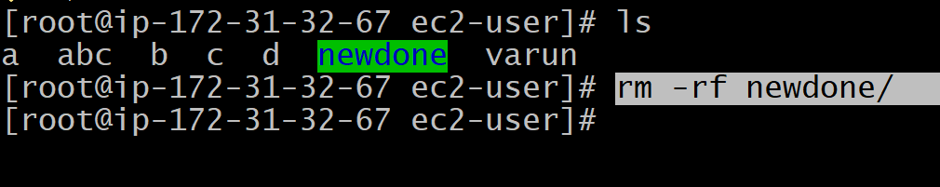
rm –rf :-
Linux rm -rf command deletes directory forcefully. It means a file or directory will be deleted anyhow even if it has read-only permission.
To delete a file forcefully, use command:
Syntax : rm -f <file name>
To delete a directory forcefully, use command:
syntax : rm -rf <directory name>

Slide 26
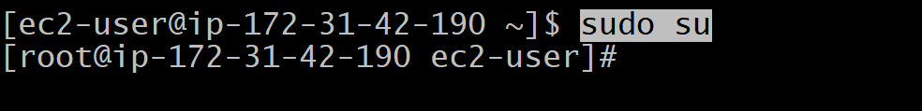
echo : To print the content.
Sudo : "SuperUser Do". So, if you want any command to be done with administrative or root privileges.

Slide 27
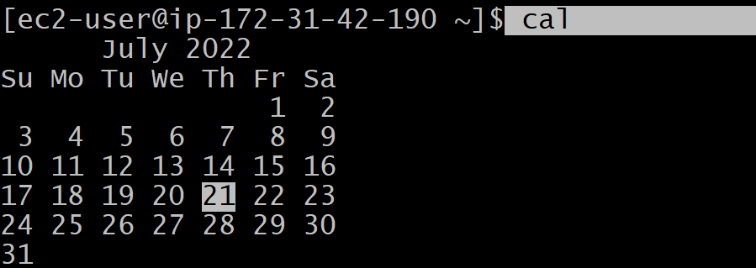
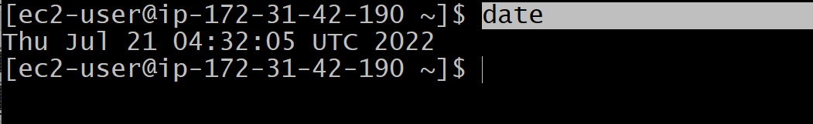
Cal : Displays calendar.
Date : Displays the current date.
date +"%D-%T” ---to print the date & time.

Slide 28
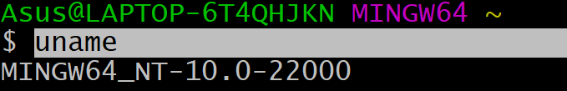
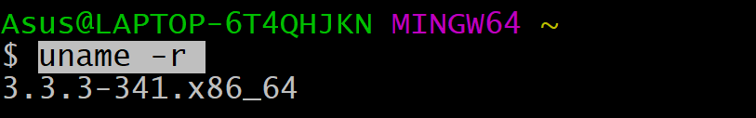
Uname : To know about kernel name along with the system information like version, os, machine , kernel release .
Uname : It will print the kernel name.
Uname –r : To know about kernel release.

Slide 29

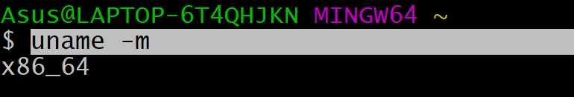
Uname –v : To know about kernel version.
Uname –m : To know about machine.

Slide 30
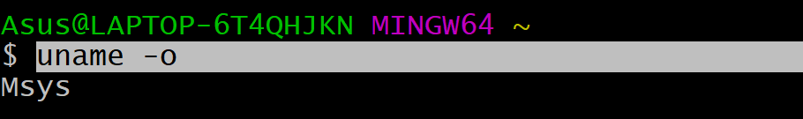
Uname –o : To know about operating system.
Uname –a : To know about complete details.

Slide 31
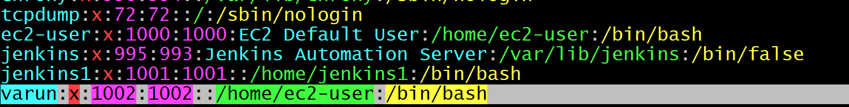
User management
User management includes everything from creating a user to deleting a user on your system. User management can be done in three ways on a Linux system.
Graphical tools are easy and suitable for new users, as it makes sure you'll not run into any trouble.
Command line tools includes commands like useradd, userdel, passwd, etc. These are mostly used by the server administrators.
Third and very rare tool is to edit the local configuration files directly using vi.
vi /etc/passwd

Slide 32
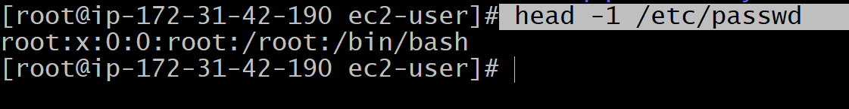
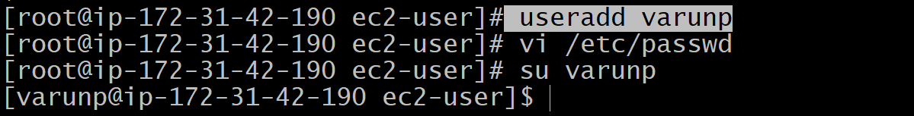
Root : The root user is the superuser and have all the powers for creating a user, deleting a user and can even login with the other user's account. The root user always has userid 0.
Useradd : With useradd commands you can add a user.
Syntax : useradd <username>

Slide 33
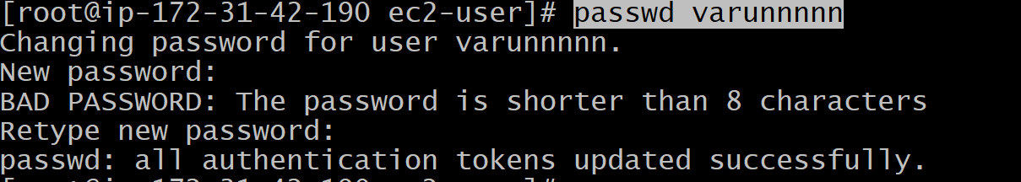
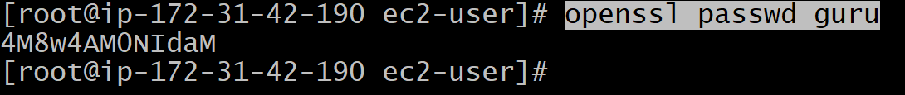
Passwd : A user can set the password with the command passwd.
Syntax : passwd <username>
Openssl : encrypted password can be generated with openssl passwd command.
syntax : openssl passwd <user_name>

Slide 34
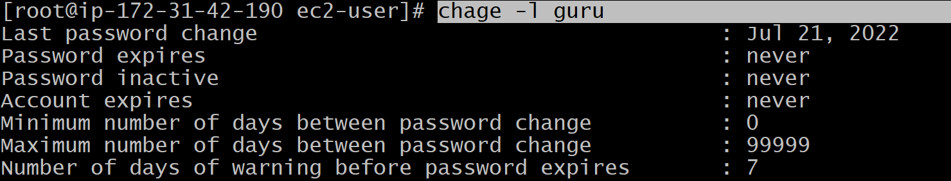
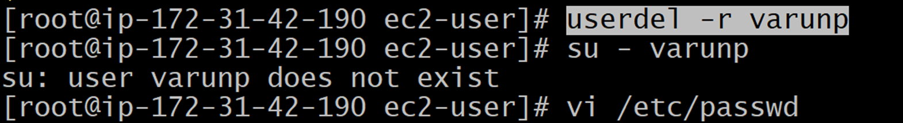
Chage : The chage command can be used by a user to know the information about their password. The -l option is used to list the information. syntax : chage –l <username>
Userdel : To delete a user account userdel command is used. Syntax: userdel -r <userName>

Slide 35
Disabling A Password : This feature can be used to disable a password and the process is called locking, disabling and suspending a user account. It can be done in vi or with usermode command.
Syntax : usermod -L <userName>
Activating the password : You can unlock your account with usermod -U.
Syntax : usermod -U <userName>

Slide 36
Linux Groups
Users can be listed in different groups. Group allow us to set permission on the group level instead of setting the permission on individual level.
Every Linux distribution have a graphical tool to manage groups. Groups can be managed by graphical tools, command line tools and by vi depending upon the user's experience. Only experienced users should use vi to manage groups, since it will do proper locking or changes in the file.

Slide 37
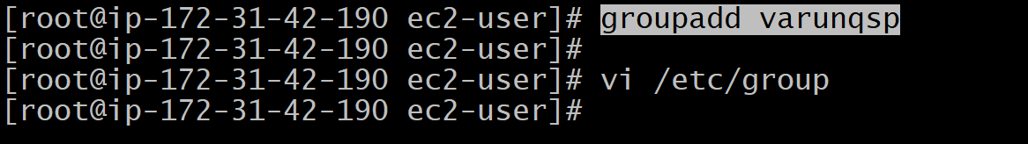
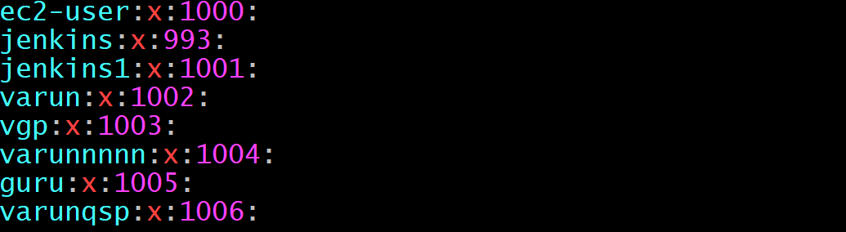
Groupadd : The groupadd command creates or add a group in our system.
syntax : groupadd <group-name>
Group File : The /etc/group file defines the group membership. A user can be a member of more than one group.
Syntax : vi /etc/group

Slide 38
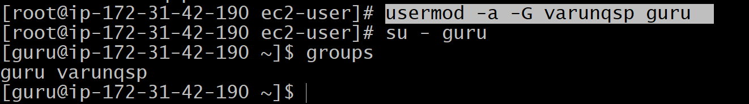
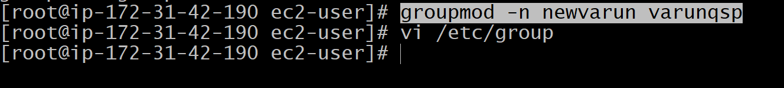
Usermod : The group members can be edited with usermod . syntax : usermod -a -G <group> <userName>
Groupmod : With the help of groupmod command you can change the name of an already existing group. syntax : groupmod -n <newGroup> <oldGroup>

Slide 39
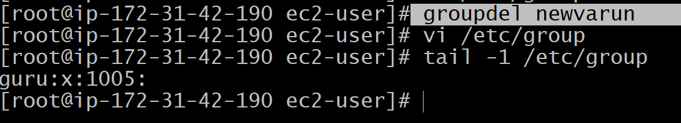
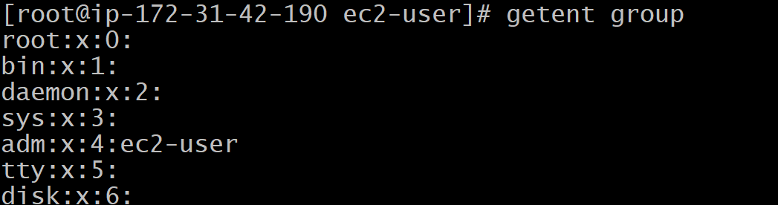
Groupdel : The command groupdel will delete a group permanently from the system. Syntax : groupdel <group>
Getent : Many groups exist in Linux; these groups can be user-defined as well as pre-defined. We can list all the available groups by using getent command. Syntax : getent group

Slide 40
Remove a User from Group : The Linux system allows us to remove a user from a group. To remove a user from a group.
syntax : gpasswd -d <user-name> <Group-name>

Slide 41
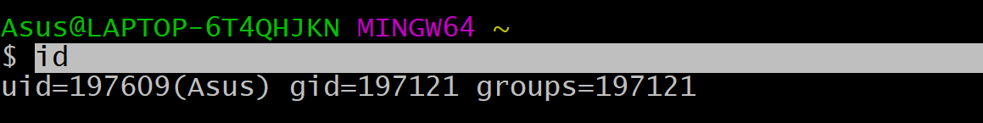
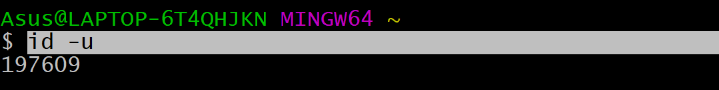
Id : Information about user-id,group-id.
Id –u : To know about user-id.

Slide 42
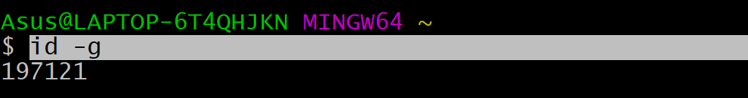
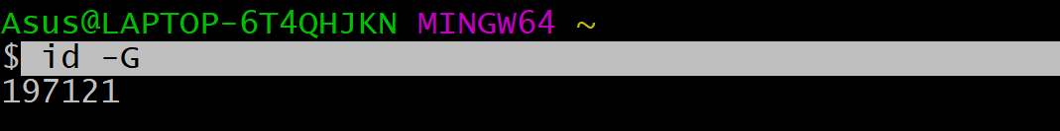
Id –g : To know about group-id.
Id –G : To know about all the group-Id.

Slide 43
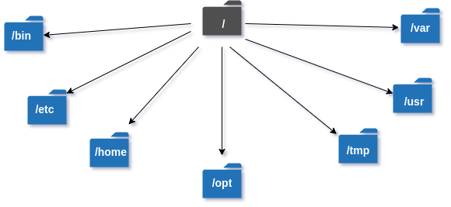
File management
A directory is a file the solo job of which is to store the file names and the related information. All the files, whether ordinary, special, or directory, are contained in directories.

Slide 44
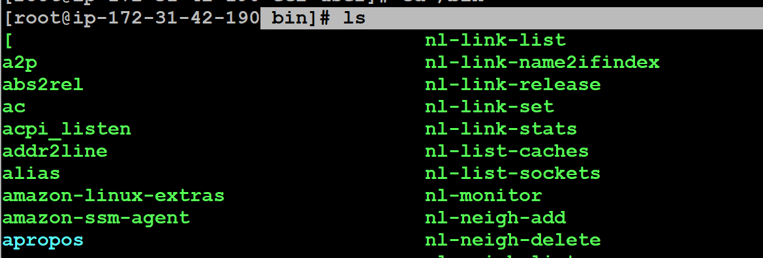
/bin : The '/bin' directory contains user binaries, executable files, Linux commands that are used in single user mode, and common commands that are used by all the users, like cat, cp, cd, ls, etc.

Slide 45


/etc : The /etc (et-see) directory is where a Linux system's configuration files live.
/etc/shells : To know details about shells.

Slide 46

/home : The Linux home directory is a directory for a particular user of the system and consists of individual files. It is also referred to as the login directory. This is the first place that occurs after logging into a Linux system. It is automatically created as "/home" for each user in the directory'.
This is file is by default present.

Slide 47

/tmp : Web servers have a directory named /tmp used to store temporary files. Many programs use this /tmp directory for writing temporary data and generally remove the data when it is no longer needed. Otherwise the /tmp directory is cleared when the server restarts.

Slide 48

/opt : /opt as “reserved for the installation of add-on application software packages.” In this context, “add-on” means software that is not part of the system; for example, any external or third-party software.

Slide 49


/usr : Short for user, usr is a directory used in Linux and Unix systems that is the location of user programs and files.
/var : /var is a standard subdirectory of the root directory in Linux and other Unix-like operating systems that contains files to which the system writes data during the course of its operation.

Slide 50

Listing Directories : To list the files in a directory. Syntax : ls dirname.
Creating Parent Directories : -p option to the mkdir command. It creates all the necessary directories for you. Syntax : mkdir -p /folder1/folder2

Slide 51

Renaming Directories : The mv (move) command can also be used to rename a directory syntax : mv olddir newdir

Slide 52
File permission
Owner permissions − The owner's permissions determine what actions the owner of the file can perform on the file.
Group permissions − The group's permissions determine what actions a user, who is a member of the group that a file belongs to, can perform on the file.
Other (world) permissions − The permissions for others indicate what action all other users can perform on the file.

Slide 53
File Access Modes
The permissions of a file are the first line of defense in the security of a Unix system. The basic building blocks of Unix permissions are the read, write, and execute permissions, which have been described below −
Read :
Grants the capability to read, i.e., view the contents of the file.
Write :
Grants the capability to modify, or remove the content of the file.
Execute :
User with execute permissions can run a file as a program.

Slide 54
Directory Access Modes
Directory access modes are listed and organized in the same manner as any other file. There are a few differences that need to be mentioned −
Read :
Access to a directory means that the user can read the contents. The user can look at the filenames inside the directory.
Write :
Access means that the user can add or delete files from the directory.
Execute :
Executing a directory doesn't really make sense, so think of this as a traverse permission.
A user must have execute access to the bin directory in order to execute the ls or the cd command.

Slide 55

Using chmod in Symbolic Mode
Chmod operator | Description
+ | Adds the designated permission(s) to a file or directory.
- | Removes the designated permission(s) from a file or directory.
= | Sets the designated permission(s).

Slide 56

Chmod Calculator

Slide 57

Chmod : The chmod (short for change mode) command is used to manage file system access permissions on linux
Giving permission in symbolic mode

Slide 58

Giving permission by using numerics

Slide 59

File :-
File command is used to determine the file type. It does not care about the extension used for file. It simply uses file command and tell us the file type. It has several options.
Syntax : file <file-name>
Options :
File * : This command is used to obtain the type of all files of the current directory.
syntax : file *
File [range]* : With the help of this command you can specify a range of the alphabets for the files you want. It will list out only those files which starts from the alphabets present in the range.
Syntax : file [range]*

Slide 60

Networking Commands
Ifconfig : It is a command-line interface tool for network interface configuration and is also used to initialize interfaces at system boot time.
used to view the IP Address, Hardware / MAC address, as well as MTU (Maximum Transmission Unit) size of the currently active interfaces.

Slide 61


Ping (Packet Internet Groper) : Is a utility normally used for testing connectivity between two systems on a network (Local Area Network (LAN) or Wide Area Network (WAN)). It uses ICMP (Internet Control Message Protocol) to communicate to nodes on a network.
Route : The route is a command-line utility for displaying or manipulating the IP routing table of a Linux system. It is mainly used to configure static routes to specific hosts or networks via an interface.

Slide 62

Netstat : Is a command-line tool that displays useful information such as network connections, routing tables, interface statistics, it is also a fundamental network service debugging tool used to check which programs are listening on what ports

Slide 63

ss (socket statistics) : Is a powerful command-line utility to investigate sockets. It dumps socket statistics and displays information similar to netstat. In addition, it shows more TCP and state information compared to other similar utilities.

Slide 64


host command : Is a simple utility for carrying out DNS lookups, it translates hostnames to IP addresses and vice versa.
Nslookup : Nslookup is also a popular command-line utility to query DNS servers both interactively and non-interactively. It is used to query DNS resource records (RR). You can find out the “A” record (IP address) of a domain as shown.

Slide 65

dig (domain information groper) : Is also another simple DNS lookup utility, that is used to query DNS related information such as A Record, CNAME, MX Record etc.

Slide 66

Last
The last command displays information about the last logged-in users. It's pretty convenient and handy when we need to track login activities or investigate a possible security breach.

Slide 67

arp
The command arp stands for Address Resoslution Protocol. It allows us to view or add content into kernel's ARP table.

Slide 68
#Display the Domain Name hostname -d
#Display IP Address uname -p #Display DayNumber in a year hostname -i
#Display current week Number date +%u
#Display Linux Flav Name uname -s
#Display Name of the Processor Uname -p
#Display Date in yyyy/mm/dd date +%F
#Display day number in a year cal -j

Slide 69
Linux I/O Redirection
Redirection can be defined as changing the way from where commands read input to where commands sends output. You can redirect input and output of a command.
For redirection, meta characters are used. Redirection can be into a file (shell meta characters are angle brackets '<', '>') or a program ( shell meta characters are pipesymbol '|').

Slide 70
Standard Streams In I/O Redirection
The bash shell has three standard streams in I/O redirection:
standard input (stdin) : The stdin stream is numbered as stdin (0). The bash shell takes input from stdin. By default, keyboard is used as input.
standard output (stdout) : The stdout stream is numbered as stdout (1). The bash shell sends output to stdout. Output goes to display.
standard error (stderr) : The stderr stream is numbered as stderr (2). The bash shell sends error message to stderr. Error message goes to display.

Slide 71

Linux Input Redirection
< stdin
The bash shell uses stdin to take input. In input redirection, a file is made input to the command and this redirection is done with the help of '<' sign.
Syntax: cat < <fileName>

Slide 72

Linux Output Redirection
> stdout
The stdout is redirected with a '>' greater than sign. When shell meets the '>' sign, it will clear the file (as you already know).
Example: echo Hello everyone. > afile.txt

Slide 73

Linux Error Redirection
2> stderr
Command '2>' redirects the error of an output.It helps us you to keep our display less messy by redirecting error messages.
Example: zcho hyii 2> /dev/null

Slide 74
Disk utilities
Disk Utilities make it easy for system administrators to easily monitor and manage disk partitions in Linux. In this article, we will look at the most popular disk utilities in Linux. Most of them are available in almost every Linux distribution, by default.

Slide 75

fdisk (for fixed disk) : Is a popular disk utility to create and manage disk partitions in Linux. It supports GPT, MBR, Sun, SGI, and BSD partition tables. You can use it to create, resize, modify, delete and move disk partitions. The following command will display all partition tables on your disk.
syntax : fdisk -l

Slide 76


df : If you want to monitor the disk usage, then df is the most popular command for this purpose. Here is a command to display total disk size, used space, available space and usage percent in human readable formats.
By using df
By using df -hT it will show the content human readable format

Slide 77

parted
parted is another popular command for managing disk partitions. It is used to create new partitions and re-organize existing partitions. You can also use it to copy data across disk partitions as well as hard disks.
Syntax : parted -l

Slide 78

lsblk
lsblk command (list block) displays all available information about available and mounted block devices, such as name, type, mountpoint.
blkid
blkid (block id) is a utility that displays block device attributes such as deice or partition name, label, and filesystem.

Slide 79
Pipes and Filter commands
pipes and filters in Unix. You can connect two commands together so that the output from one program becomes the input of the next program. Two or more commands connected in this way form a pipe.
To make a pipe, put a vertical bar (|) on the command line between two commands.
When a program takes its input from another program, it performs some operation on that input, and writes the result to the standard output. It is referred to as a filter.

Slide 80
Linux File Contents
Commands | Function
head | It displays the beginning of a file.
Tail | It displays the last last part of a file.
Cat | This command is versatile and multi worker.
Tac | Opposite of cat.
More | Command line diaplays contents in pager form that is either in more format.
less | Command line diaplays contents in pager form that is either in less format.

Slide 81
HEAD
Displays the first n lines of the specified text files. If the number of lines is not specified then by default prints first 10 lines.
Syntax:- head file_name
-n | It will print specified number of lines Syntax : head –n(num) <file-name>
-c | It will print specified number of character (byte) Syntax : head –c <num> <file-name>
-q | It will not print filename or not print fully detailed content Syntax : head –q <file-name>
-v | It will print content fully detailed along with filename Syntax : head –v<file-name>

Slide 82
TAIL
It works the same way as head, just in reverse order. The only difference in tail is, it returns the lines from bottom to up.
syntax :- tail file_name
-n | It will print specified number of lines Syntax : tail –n(num) file-name
-c | It will print specified number of character (byte) Syntax : tail –c num <file-name>
-q | It will not print filename or not print fully detailed content Syntax : tail –q <file-name>
-v | It will print content fully detailed along with filename Syntax : tail –v <file-name>

Slide 83

Pipeline(|)
The pipeline is a operator that lets you use two or more commands such that output of one command serves as input to the next.
Ex:- cat file.txt | tail +4 | head –n 4

Slide 84

Sort
Sort command is used to sort the content(alphabets,numbers) in ascending or descending order based on user input
Sorts the lines alphabetically by default but there are many options available to modify the sorting mechanism. Be sure to check out the main page to see everything it can do.
-r :-Is for sort in reverse order
syntax : sort –r <file-name>
-n :- Is for sort based on numerics
syntax : sort –n <file-name>
Note :- It will print according to asci

Slide 85

Uniq
It is helpful to remove or delete duplicate entries in a content or data
syn:- uniq filename
-c | count the number of occurance
-d | Display only duplicate content

Slide 86
Cat
Option | Function
cat > [fileName] | To create a file.
cat [oldfile] > [newfile] | To copy content from older to new file.
cat [file1 file2 and so on] > [new file name] | To concatenate contents of multiple files into one.
cat -n/cat -b [fileName] | To display line numbers.
cat -e [fileName] | To display $ character at the end of each line.

Slide 87


Cut : Linux cut command is useful for selecting a specific column of a file.
Find : The find command is used to find a particular file within a directory. It also supports various options to find a file such as byname, by type, by date, and more.

Slide 88
Locate : The locate command is used to search a file by file name. It is quite similar to find command; the difference is that it is a background process. It searches the file in the database, whereas the find command searches in the file system. It is faster than the find command. To find the file with the locates command, keep your database updated.
sleep : The sleep command is used to hold the terminal by the specified amount of time. By default, it takes time in seconds.

Slide 89

Grep
The 'grep' command stands for "global regular expression print". grep command filters the content of a file which makes our search easy.
syntax : grep <searchWord> <file name>
grep with pipe
The 'grep' command is generally used with pipe (|).
syntax : command | grep <searchWord>

Slide 90
Sed
Linux 'sed' command stands for stream editor. It is used to edit streams (files) using regular expressions. But this editing is not permanent. It remains only in display, but in actual, file content remains the same.
Primarily, it is used for text substitution; additionally, it can be used for other text manipulation operations like insert, delete, search, and more. The sed command allows us to edit files without opening them.
Ex: sed ‘s/old-content/new-one/’ <file-name>
1)changing all;-
ex; sed ‘s/sam/manu/g’ sakmanu.txt
2)printing;-
ex;-sed ‘s/sam/manu/p’ manu.txt

Slide 91
3) Replacing in nth line:-
1.ex;- sed ‘3 s/sam/manu/’ sakmanu.txt
2.ex:- sed ‘1,3 s/sam/manu/’ sakmanu.txt
4) printing only replaced data;-
ex;- sed –n ‘s/sam/manu/p’ sakmanu.txt
Note:- if we not mention “/p” it will not print
5) Delete the line or content:-
1.ex;-sed ‘2d’ sakmanu.txt
2.ex;-sed ‘$d’ sakmanu.txt
6) using pipe command:
ex : echo hello | sed ‘s/hello/done/’

Slide 92


tr : The command 'tr' stands for 'translate'. It is used to translate, like from lowercase to uppercase and vice versa or new lines into spaces.
Ex : cat a | tr hi HI
Ls – lrt :

Slide 93
Awk command
The awk command is used for text processing in Linux. Although, the sed command is also used for text processing, but it has some limitations.
The Awk is a powerful scripting language used for text scripting. It searches and replaces the texts and sorts, validates, and indexes the database.
It acts as a filter in Linux. It is also referred as gawk (GNU awk) In Linux.
Features of AWK command
It scans a file line by line.
It splits a file into multiple fields.
It compares the input text or a segment of a text file.
It performs various actions on a file like searching a specified text and more.
It formats the output lines.

Slide 94

awk ‘/option/ {print}’ file-name

Slide 95
awk ‘{print}’ file.name ---→ To print the content.
awk ‘{print $1,$2}’ file-name --→ To print the specified column .
awk ‘{print NR,$0}’ file-name --→ To print the serial number along with content.
awk ‘{print $NF}’ file-name -→ To print the last field of file.

Slide 96
File compression
 | Tar usage and options
c | To Create a archive file
x | To extract an archived file
v | To show the progress of archived file
T | To view the content present in archived file
J | To filter archived file through bzip2
Z | To filter archived file through gzip
R | To append or update files to existing archived file

Slide 97


tar (tape archive)
The tar command is not specifically a compression command. It’s generally used to pull a number of files into a single file for easy transport to another system or to back the files up as a related group.
To tar the file.
To untar the file.

Slide 98


ZIP
ZIP is a type of archive file format. It supports lossless data compression (meaning, perfect reconstruction of original data from compressed data). A ZIP file may also contain more than one compressed file/directory.
To zip the file.
To unzip the file.

Slide 99


gzip
Gzip (GNU zip) is a free and open source algorithm for file compression. The software is overseen by the GNU project. In this context, compression is the deliberate reduction in size of data to save storage space or increase the data transfer rate.
To gzip the file.
To decompress the file.

Slide 100

crontab
Cron is named after Greek word “Chronos” that is used for time. It is a system process that will automatically perform tasks as per the specific schedule. It is a set of commands that are used for running regular scheduling tasks. Crontab stands for “cron table”. It allows to use job scheduler, which is known as cron to execute tasks.
Crontab is also the name of the program, which is used to edit that schedule. It is driven by a crontab file, a config file that indicates shell commands to run periodically for the specific schedule.

Slide 101


Write one shell script and output of the shell script will get stored in one path
Crontab -e
Create on cronjob and it will get execute every minute

Slide 102



It will trigger the shell script based on the cronjob & it will get execute
To list the cronjobs
To remove the cron jobs.

Slide 103
Some examples on cronjob
Description | Command
Cron command to do the various scheduling jobs. Below given command execute at 7 AM and 5 PM daily. | 0 7,17 * * * /scripts/script.sh
Command to execute a cron after every 5 minutes. | */5* * * * * /scripts/script.sh
Cron scheduler command helps you to execute the task on every Monday at 5 AM. This command is helpful for doing weekly tasks like system clean-up. | 0 5 * * mon /scripts/script.sh
Command run your script on 3 minutes interval. | */3 * * * * /scripts/monitor.sh
Command to schedule a cron to which executes for a specific month. This command to run tasks run in Feb, June and September months. Sometimes we need to schedule a task to execute a select monthly task. | * * * feb,jun,sep * /script/script.sh
Command to execute on selected days. This example will run each Monday and Wednesday at 5 PM. | 0 17 * * mon,wed /script/script.sh

Slide 104
Thank you

